Slide 1
Project presentation (week 2)
Submitted to :
Ashfaq Ali Shafin
Lecturer
Dept. of CSE
Stamford University,
Bangladesh
Submitted by:
Group:
( Creative Originality )
Tahmim Al Ashik CSE06307448
Sharmi Mondal CSE06307454
Md. Jafor Iqbal CSE06307452

Slide 2
Intention
DFD (Data Flow Diagram ) of our project

Slide 3
DFD
Context or 0 level DFD
Level 1 DFD

Slide 4
DFD Elements
Entity sign denotes user
Data store sign denotes data store of company and product
level denotes processes of the diagram

Slide 5
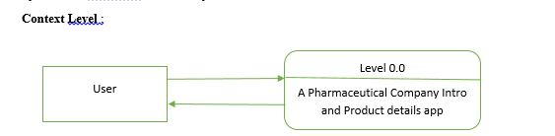
Context Level

Slide 6
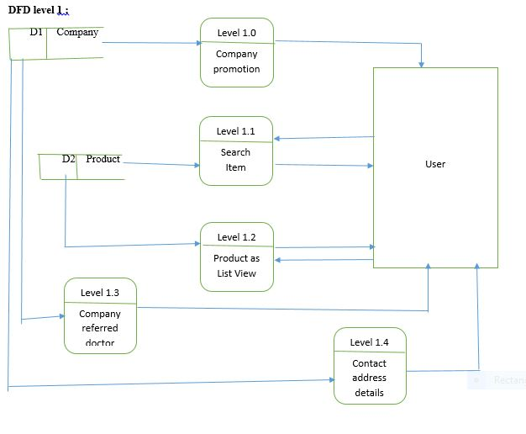
Level 1 DFD

Slide 7
Thank You

